Slide 1
To-Do List Android Project
By Ben Faulkner

Slide 2
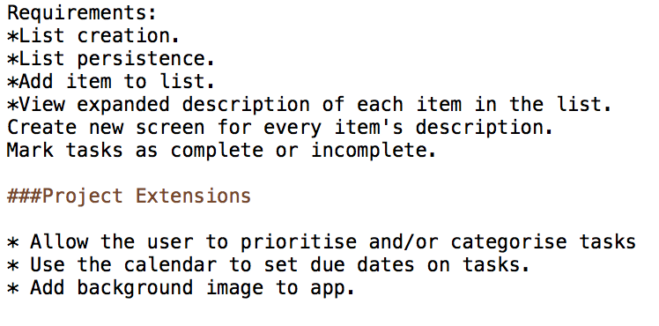
Planning

Slide 3
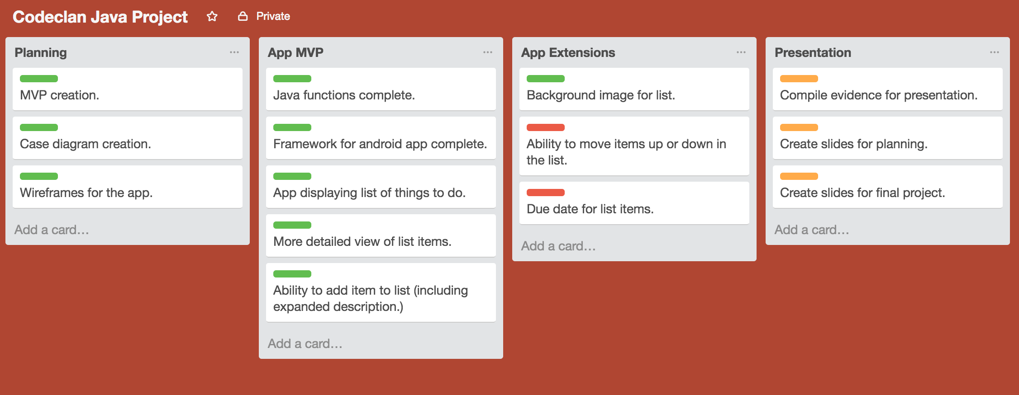
Planning

Slide 4
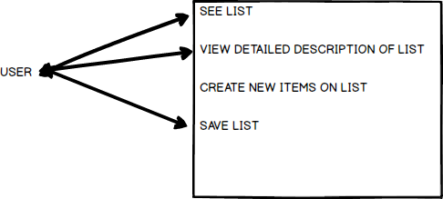
Case Diagrams

Slide 5
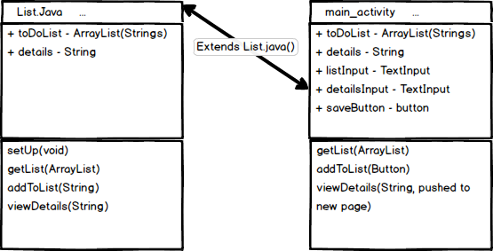
Case Diagrams

Slide 6
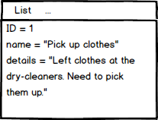
Case Diagrams

Slide 7
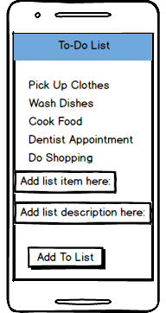
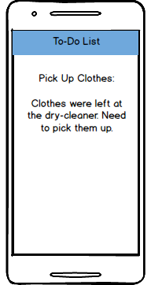
Mockups

Slide 8
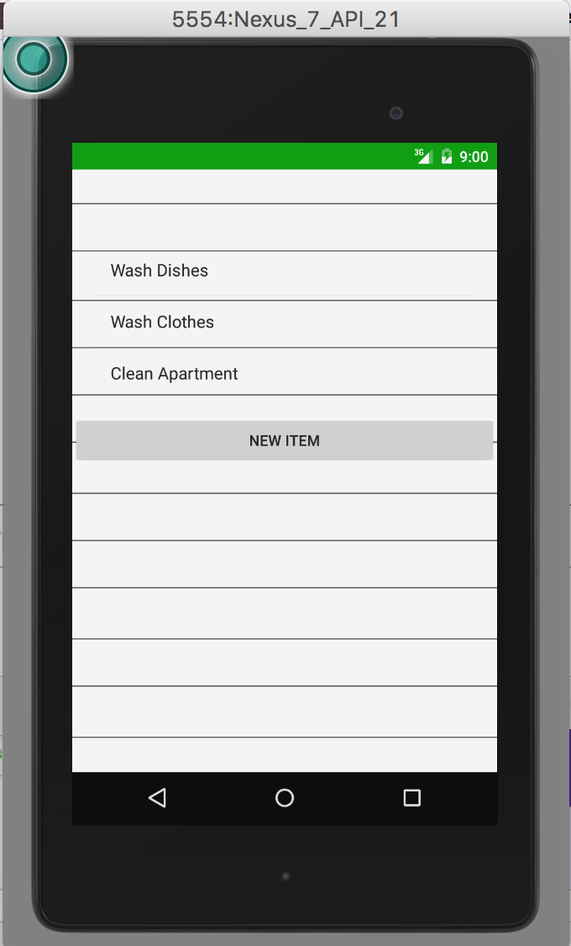
Execution

Slide 9
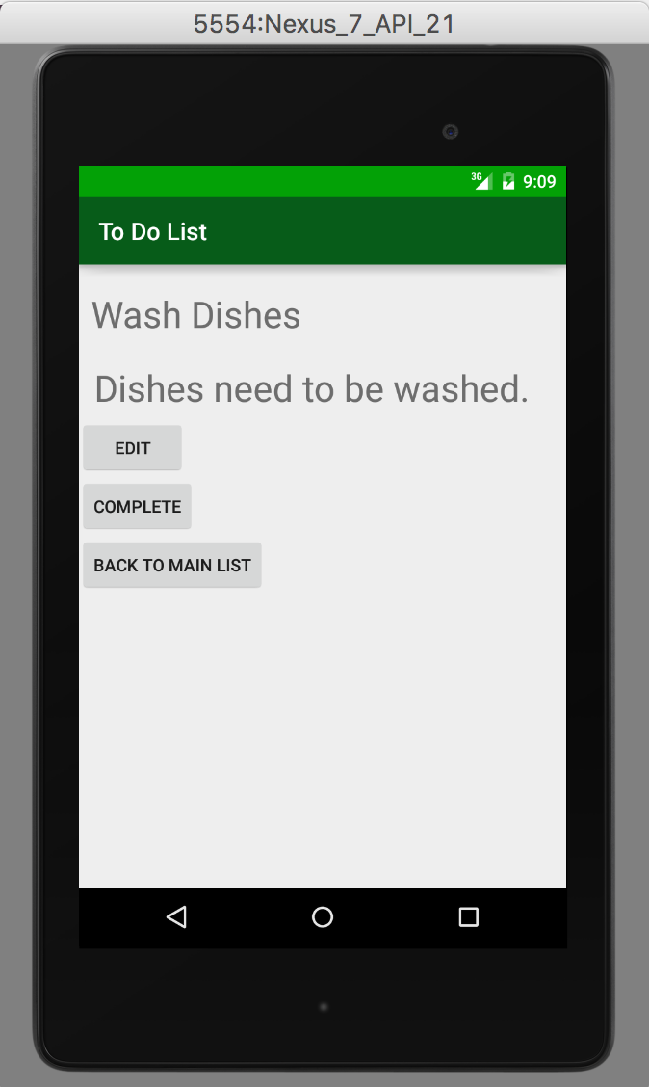
Execution

Slide 10
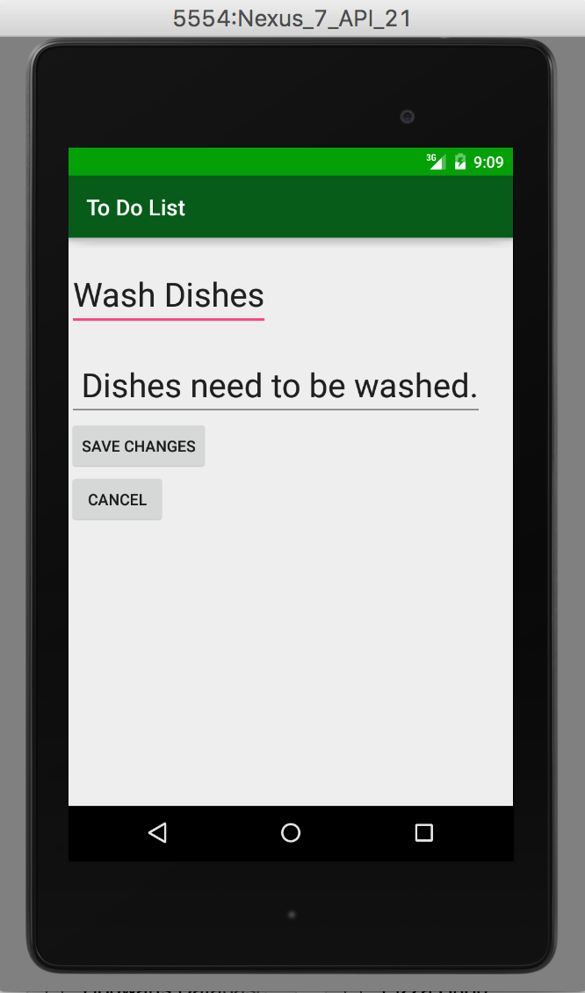
Execution

Slide 11
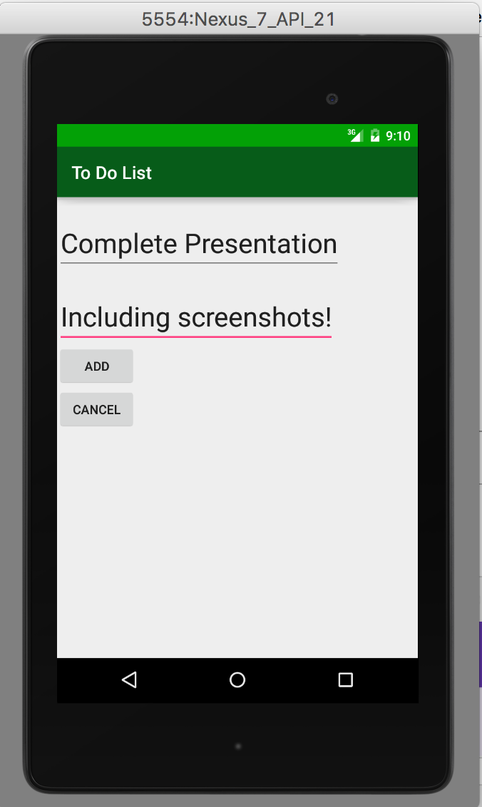
Execution

Slide 12
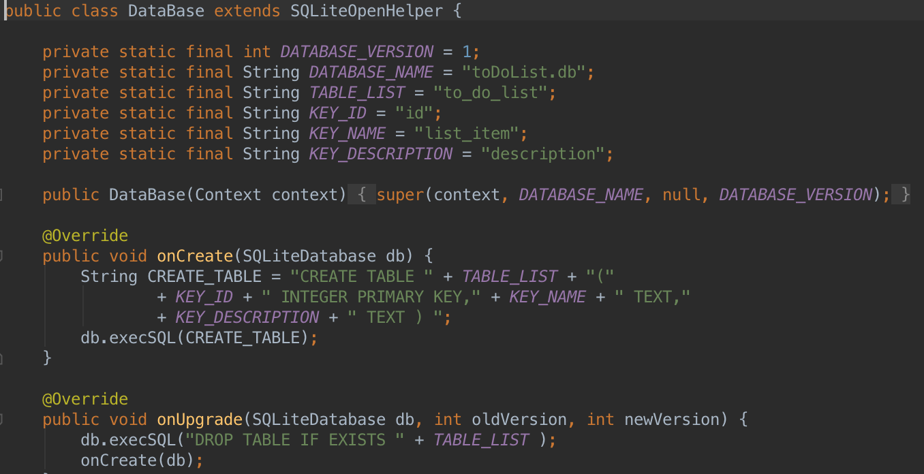
SQL Persistence

Slide 13
Conclusion
Much happier with how this project came out.
More time, less sickness, better on the whole.
Learned how to deal with some more esoteric errors while dealing with Android Studio.
Questions?

